Slide 1
Roy Bhaskar and Critical Realism
Empirical
Actual
Real
Notes:
Philosophical studying of being
Empirical---- is epistemological (everything accepted as knowledge). All that has been seen observed and experienced.
Actual--- all that you see and observe yourelf
Real------ which is needed to understand the world

Slide 2
BOURDIEU AND SYMBOLIC VIOLENCE
Week 5
Selected Topics in Sociology

Slide 3
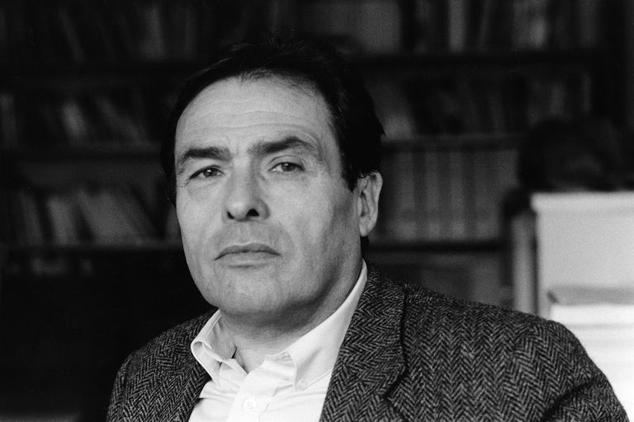
PIERRE BOURDIEU BIOGRAPHY
1930-2002
French Sociologist
French Army during Algerian War of Independence (1958-62)
War between France and the Algerian National Liberation Front from 1954 to 1962, which led to Algeria gaining its independence from France.
Notes:
Organization of social practices, combining the symbolic and the material. Bourdieu’s engagement with ‘the social’ was not simply a theoretical position but the product of an acute interest in social inequality and the ways in which it is masked and perpetuated
Algerian War:
The bloody battle of Algiers was a formative experience for a generation of French intellectuals who saw their state betray what it had always claimed was a mission of liberation and civilization, revealing the sheer power that lay behind colonialism,
In 1955, Bourdieu was sent to do national service in Algeria during that French colony’s struggle for independence —
Confrontation with the Algerian war, and with the transformations wrought by French colonialism and capitalism, left a searing personal mark on Bourdieu, solidifying his commitment to the principle that research must matter for the lives of others
Hundreds of thousands of people died in the Algerian War but Bourdieu was uniquely positioned by his willingness to provide an ethnographic study
Ethnography: Ethnographic research is a qualitative method where researchers observe and/or interact with a study's participants in their real-life environment

Slide 4
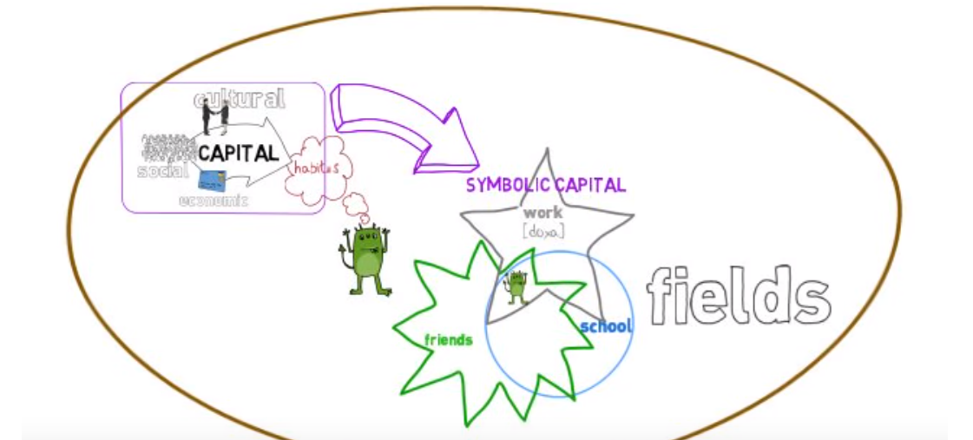
THEORY OF CAPITALS
Notes:
Bourdieu’s development of the notion of habitus as a way of integrating structural and agency
Habitus simply means who you are as a person. It describes who you are today based on your upbringing and the people and situations that has influenced you while growing up. ...
It ingrained habits, skills, and dispositions. It is the way that individuals perceive the social world around them and react to it.
Usually shared by people with similar backgrounds (such as social class, religion, nationality, ethnicity, education, profession etc.)
Field is a setting in which agents and their social positions are located. Ask Class for examples of different fields.

Slide 5
Economic Capital – access to income, wealth or property; physical assets, that produce profits and persist; can be simply bestowed or transferred
Cultural Capital – prestige associated with specialized knowledge, not tangible; ability to interpret institutional requirements (or the rules of the game) that allow people to succeed or achieve a higher status in society; spoke of high or legitimate culture, and popular culture
Social Capital – connections to others and benefits conferred; obligations and networks of trust based on group membership; advantages lead to success.
4 . Symbolic Capital – ability of actors to use practices to defend or maintain their positions; to show their positions to be desirable, so that others come to perceive or recognise their positions as legitimate.
Notes:
Capital is the currency that buys your position in society
Foundation of social life
What decides your role in the social world
Capital is the result of labour
‘’more time you spend accumulating a form of capital the more valuable the capital is’’ IE. If you inherit capital it carries more value than if you earn it yourself.
Social and Cultural Capital- what you have and what you know
-embodied
-objectified
-institutionalised- Symbols of cultural competence and authority
Education. (title). University degrees.
Shared Cultural Capital
Creates a feeling of collective identity
Share values, belief, dress and behaviour
Social Capital
If cultural capital is what you know and what you have then social capital is WHO you know
Your social capital depends on social network.
Gained through relationships you inherit.
Groups share their capital and so it becomes part of collective capital
Bourdieu wanted to explain social capital and power dynamics in society
Economic Capital- economic capital can be turned into other forms of capital over time Of those who are described as poor, using the Apartheid racial classification system, 93.3% are black, 6.3% are coloured, 0.4% are Indian, and 0.1% are white (Statistics South Africa
Symbolic Capital- reinforces other forms of capital through legitimatisation and recognition

Slide 6
CAPITALS
Key in locating people in social space
Result in social reproduction
Understanding capitals allows for the disruption of privilege, and transformation of power
“Every type of capital is reducible in the last analysis to economic capital” (Bourdieu, 1977/ 1997, p. 54).
Unequal distribution of capital – in all its forms – explain why societies are structurally stratified and not merely dependent on “simple games of chance… so that everything is not equally possible” (Bourdieu, 1977/ 1997, p. 46) for all members
Notes:
Why do you think it is important to understand how capitals work

Slide 7
So in first year there was a physics paper that I wrote and it spoke about ping pong…but I never actually – and you had to sort of draw a sketch of how the ball has to travel and the thing is I didn’t know what a ping pong was [laughs]…For the life of me I didn’t know what ping pong was because those are not the games I grew up playing and all those sort of things” (Tothele, South Africa, Male, 23, Black, Humanities)
Moral Eyes. 2018. HSRC Press
Notes:
What kind of capital is Tothele lacking?

Slide 8
SYMBOLIC CAPITAL (AND POWER)
Individuals perceive one another primarily through the “status” which attaches to their practices
They misperceive the real basis of these practices: the economic and cultural capital that underlies the different habitus and therefore leads to the practice
These misperceptions of honour function as ‘symbolic capital’ (Bourdieu 1991, p. 238).
“[T]he very lifestyle of the holders of power contributes to the power that makes it possible, because its true conditions of possibility remain unrecognized” (Bourdieu, 1990a, p. 139).
This misperception of social space—which characterizes both the dominant and the dominated, albeit to the advantage of the latter—is also “symbolic violence.”
Notes:
Status which attaches to their practices.
Lets talk about Language. How does language/ or linguistic Capital work? Does language give you “status”

Slide 9
CAPITALS AND THE REPRODUCTION OF CLASS THROUGH EDUCATION
Social and cultural capital is accumulated over time and “cannot be transmitted instantaneously . . . by gift or bequest, purchase or exchange” (Bourdieu, 1977/1997, p. 48), but by “presuppos[ing] a specific labor, i.e. an apparently gratuitous expenditure of time, attention, care, concern” (ibid, p. 54).
Cultural and social capital linked to the possession of economic capital – which in turn buys useable time – which can then be used to transfer networks and institutional knowledge, e.g. Mothers’ or teachers’ time.
Families who already have economic capital are therefore more able to purchase this usable time.
Notes:
A black man and a white man- or a poor man and a rich man or a man and a women sit in the Matrix and have a conversation- it is a symbolically organized exchange

Slide 10
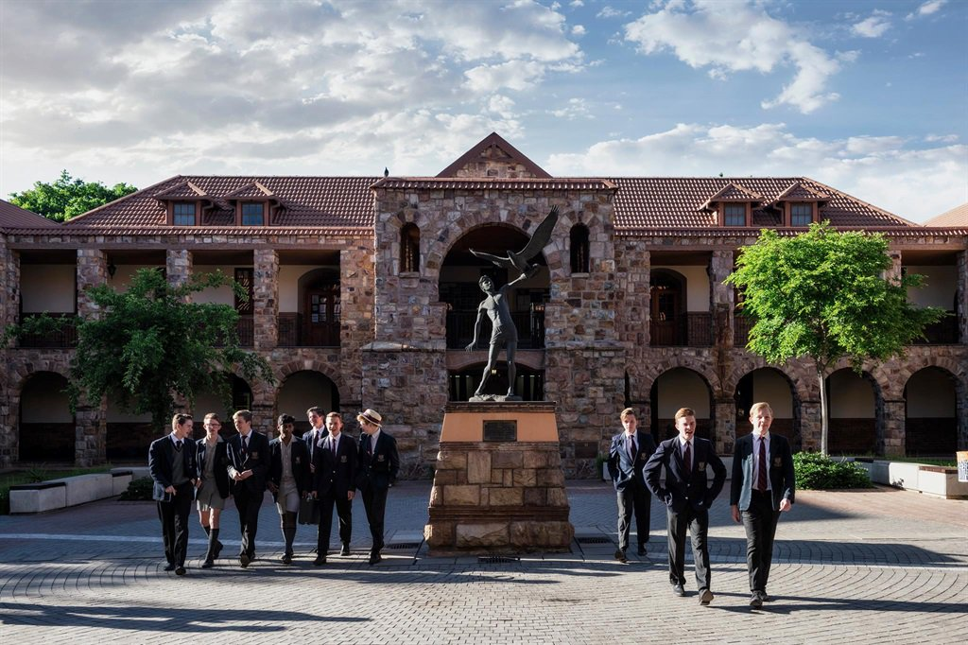
Notes:
QUESTION: WHO BELIEVES THAT EDUCATION IS A TOOL TO TRANSFORM SOCIETY AND BRING PEOPLE OUT OF POVERTY
Bourdieu believed that educational institutions present themselves as working for the common good, but in fact reproduce social inequalities. They present themselves as agents of freedom, but in fact are organizations of power.
“More than 40 percent of the St John’s class of 2018 achieved an academic average of at least 80 percent. Seventy-one percent of St John’s College students achieved an average of at least 70 percent.”
He said the 141 St John’s matriculants returned 433 distinctions in the 2018 Independent Examinations Board (IEB) exam, and of the 122 boys who wrote the Mathematics exam, 70 achieved an A.
Things that affect learning- how do these kids get to school?
In 2017 NGO EE had a massive campaign for transport to schools in KZN. In August (just one month) seven pupils died and 21 more were injured as they made their way to and from public schools in KwaZulu-Natal
Report said ‘’When these learners arrive at school, emotionally and physically exhausted, they find it incredibly difficult to learn’’
78% of Grade 4 pupils in our country cannot read for meaning, in any language.”
Sanitation Audit:
Mentorship (Ikasi students weren’t aware of the marks required for social work, law and medicine)

Slide 11
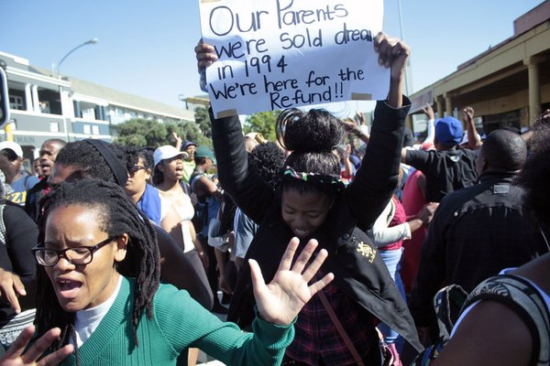
Part 2: The Quiet Violence of Dreams Sharlene Swartz , James Hamilton Harding and Ariane De Lannoy (2012)
Notes:
What happens to a dream deferred?
Does it dry up
like a raisin in the sun?
Or fester like a sore—
And then run?
Does it stink like rotten meat?
Or crust and sugar over—
like a syrupy sweet?
Maybe it just sags
like a heavy load.
Or does it explode?
Langston Hughs
What is a legacy?
Apartheid was a framework- imagine an integrated spider web placed over us- we have to tru to untangle ourselves

Slide 12
Structural vs Symbolic Violence
Structural Violence
Described by Paul Farmer (1996) as the institutionalisation of social processes that differentially cause suffering through organising unequal access to social resources, such as rights, security, capital and bodily and mental integrity, based on markers of difference.
Symbolic Violence
‘violence which is exercised upon a social agent with his or her complicity’
process of internalising identity-based oppressions associated with poverty and repressive regimes.
Notes:
In South Africa, Apartheid’s systematic exclusion (through legislation) of black people from employment, health care, education and land has resulted in the impoverishment of the majority of the population.
While Apartheid legislation has now been repealed, the legislated inequality ensured that the effects of Apartheid remained and gave birth to new social problems, not least those of continuing inequality, poverty and insecurity” (Swartz et al. 2012, p. 29).
Why is structural violence about exclusion and access: because you are not really treated or viewed as a citizen Through integration into social and economic systems, an individual becomes a social agent who is active in the processes of defining both the collective and the self
While structural violence can be used to explain limited access to both opportunities and success, Bourdieu further contributes the notion of symbolic violence (and symbolic capital) to notions of social advancement in the context of injustice and oppression.
Symbolic violence can help to explain how current legacies of poverty and injustice are “constructed mutually by the persistence of Apartheid’s social, political and economic structures, and by the tendency of a large group of subjects to accept the world as it is, engaging with their social environment in ways they are familiar with. In other words, ‘their mind is constructed according to cognitive structures that are issued out of the very structures of the world’ (Bourdieu and Wacquant, 2004, p. 272).
Symbolic violence ‘works’ through the perception of the internal coherence of differential privilege
Bourdieu Examples of Symbolic Violence:
Language 1. Accent 2. Vocabulary eg. SATs 3. Public speaking. Rules of the game. When to speak and not
Gender: walking, talking, sitting, dressing.

Slide 13
‘’Wounded Attachments’’ Poverty – how does it affect you?
Andiswa: Sjoe, very much. It’s actually putting an end stop in most of the things that I want to do because, yeah, I like [township school] but it was not my dream school, you know. I wanted to go to, um, [suburbs] school.
Thando: No, I’ve learnt, I’ve learnt to live with it - … I’ve learnt to accept it in different ways, like… I know how to, to, to help myself, but in the positive way, not in a bad way like robbing and doing drugs and going to, to break in people’s houses and all that, those things. … Mmm, I just, I just forget about it [being poor], because it, it will, at the time it will lower my self-esteem. It will make me, yah, sadness and you know, so I just keep myself listen to music, and dancing - just to forget about all these things.
Notes:
What is the ‘’cycle of poverty”’
In economics, the cycle of poverty is the "set of factors or events by which poverty, once started, is likely to continue unless there is outside intervention". Families trapped in the cycle of poverty, have either limited or no resources.
Please write a few sentences where you reflect on the role of social and cultural capital in your life? Do you believe you have benefited from these capitals? How and Why? Include in this any questions or comments you have on Symbolic Power and Violence.

Slide 14
Interviewer: What do you think of living in that shack in Khayelitsha Vathiswa?
Vathiswa: I don’t like it.
Interviewer: And why do you live in that shack?
Vathiswa: Because my mother have no money – to buy and live in the other house.
Interviewer: And why has your mother got no money? Vathiswa: She’s not working ... she didn’t get the job. Interviewer: And why are there no jobs?
Vathiswa: [long pause – hangs her head] I
Interviewer: Why do I have money and you don’t?
Vathiswa: Because my mother is not working –.
Notes:
Myth of meritocracy

Slide 15
Apartheid Mhoza: It affected our grannies cos they are all domestic workers and we don’t live in the suburbs… Coloured people’s dogs chase us.
Amande: It affects me because it affected my parents, who couldn’t be what they wanted to be.
Dipuo: There’s no apartheid. It doesn’t affect me
Phindiwe: It doesn’t affect my life. You’ve worked hard to have what you have. We haven’t achieved yet.
Nonkiza: Apartheid hasn’t affected my life. I live on a freedom world now. I will have a house like yours if I work hard.
Luxolo: When I was born there was no Apartheid. Poseletso: If you do something wrong and you are black they call you an animal… they look at you… they think you are lost.
Notes:
How did apartheid affect you

